Slide 1
E-commerce - Epey
Scraping documentation

Slide 2
1. Select category that corresponds to Television
Country | Category | Link
Turkey | TV | https://www.epey.com/televizyon/

Slide 3
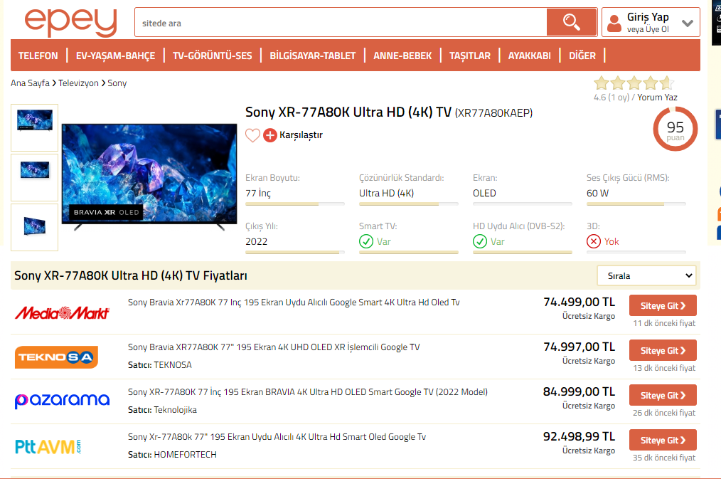
2. Elements to scrap - Main elements
Category
Brand
Title
Reference 2
Number of offers
Average price
Currency
Output
Brand | Title | Ref 2 | Nb offers | Avg price
Sony | Sony Xr-.. | (XR77A80..) | 4 | 81 748,49
Currency | Category
TL | Televizyon

Slide 4


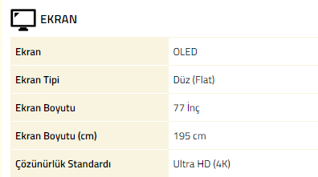
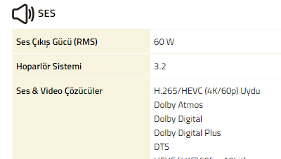
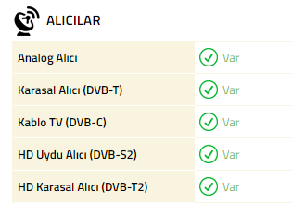
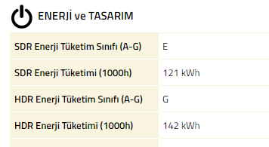
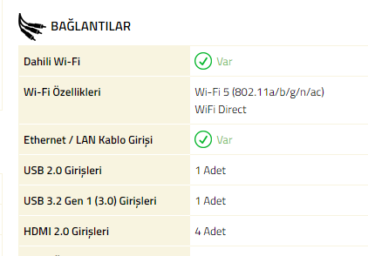
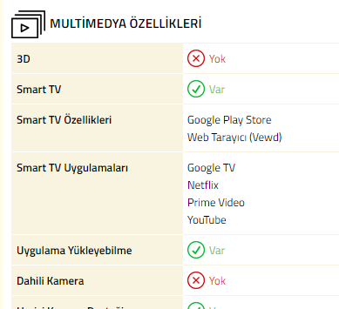
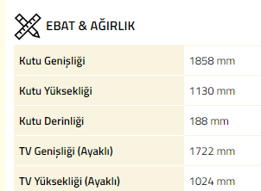
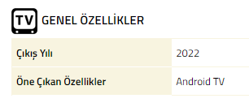
3. Elements to scrap - characteristics
Specification label
Specification value
To put in column as List year
Output
List year | Specification label | Specification value
2022 | Ekran | OLED

Slide 5
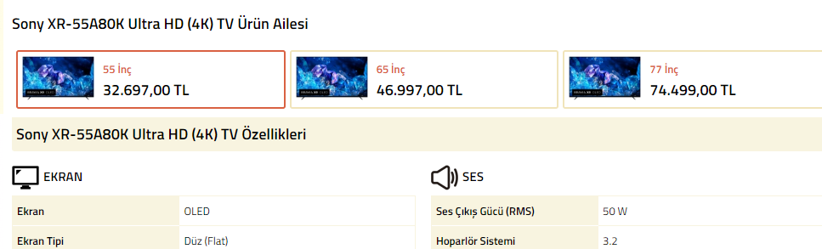
4. Other articles of same model and different size
Repeat previous steps but clicking in the other sizes, link will also change!

Slide 6
5. Final output
Country code | Brand | Title | Reference 2 | Number of offers | List year | Average price | Currency | Specification label | Specification value
TR | Sony | Sony XR-77.. | (XR77..) | 4 | 2022 | 81 748,49 | TL | Ekran | OLED
Category | Scraping date | Source URL | Source
Televizyon | 2022-12-29 | https://www.epey.com/televizyon/sony-xr-55a80k.html | EPEY
Date to be reshaped in YYYY-MM-DD format
Scraped
Added

